Slide 1
The metabolic pathway of lipids
glycerophospholipids
Synthesis of glycerophospholipids
Synthesis of triacylglycerols
Synthesis of eicosanoid
Mobilization
stored
Eicosanoid
Fatty acids
Triacylglycerol
Leukotrienes
Digestion and transport
dietary
Synthesis of leukotrienes
Fatty acid
synthesis
β-Oxidation
Ketone bodies synthesis
Cholesterol synthesis
Ketone bodies
Acetyl-CoA
Cholesterols
Ketone bodies breakdown
Notes:
Arrow——general view
synthesis of glycerophospholipids——slide 16
Synthesis of triacylglycerols——slide 16
Synthesis of eicosanoid——slide 17
Synthesis of leukotrienes——slide 18
Beta-oxidation——slide 4
Fatty acid synthesis——slide 9
Ketone bodies synthesis——slide 8
Ketone bodies breakdown——slide 8
Mobilization——slide 3
Digestion and transport——slide 2
Cholesterol synthesis——slide 19

Slide 2
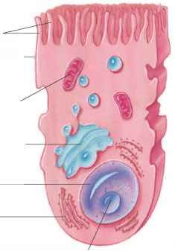
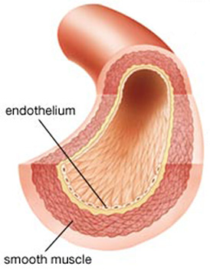

Digestion and transport of dietary triacylglycerols
triacylglycerol
Intestinal lipase
Fatty acid
ApoC-II
Fatty acid
Fatty acid
glyceral
ApoC-II
lipoprotein lipase
triacylglyceral
Chylomicron
Glycolytic pathway
Notes:
Arrow——slide 1
Glycolytic pathway——glucose metabolism
fatty acid——slide 4

Slide 3
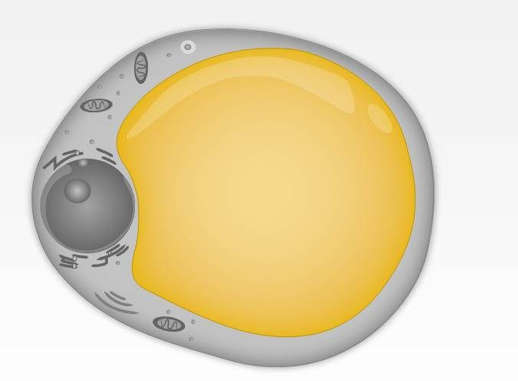
Mobilization of stored triacylglycerols
glucagon
epinephrine
Serum albumin
Fatty acid
triacylglyceral
Fatty acid
ATGL HSL MGL
Serum albumin
perilipin
Adipoctye
Notes:
Arrow——slide 1
Fatty acid——β-oxidation

Slide 4

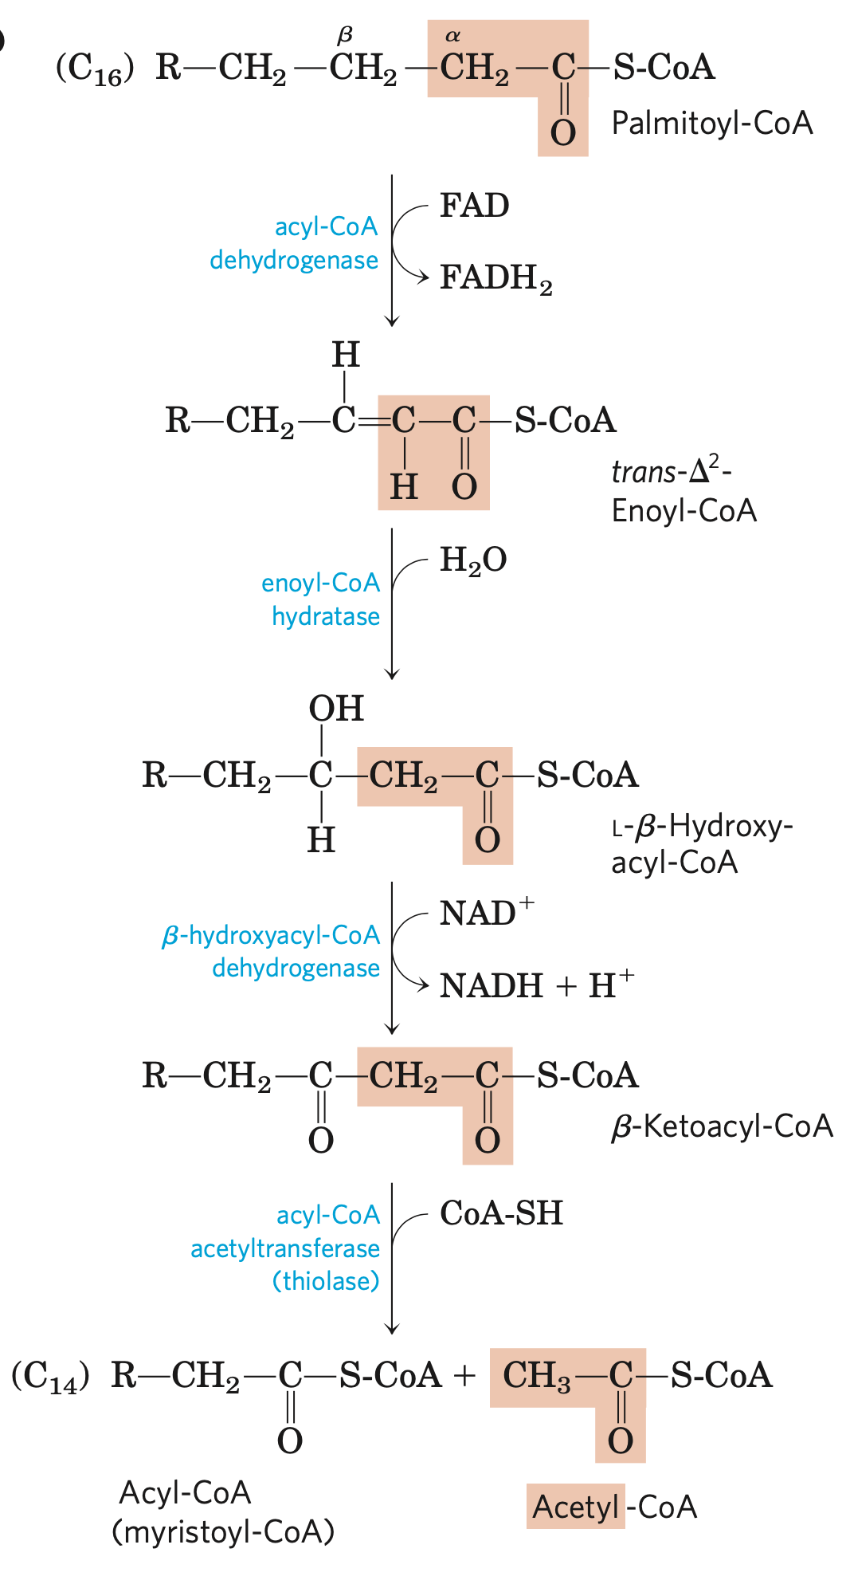
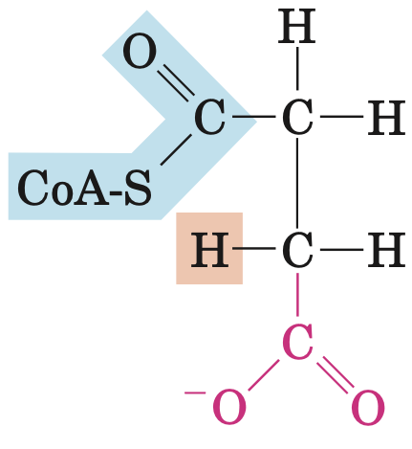
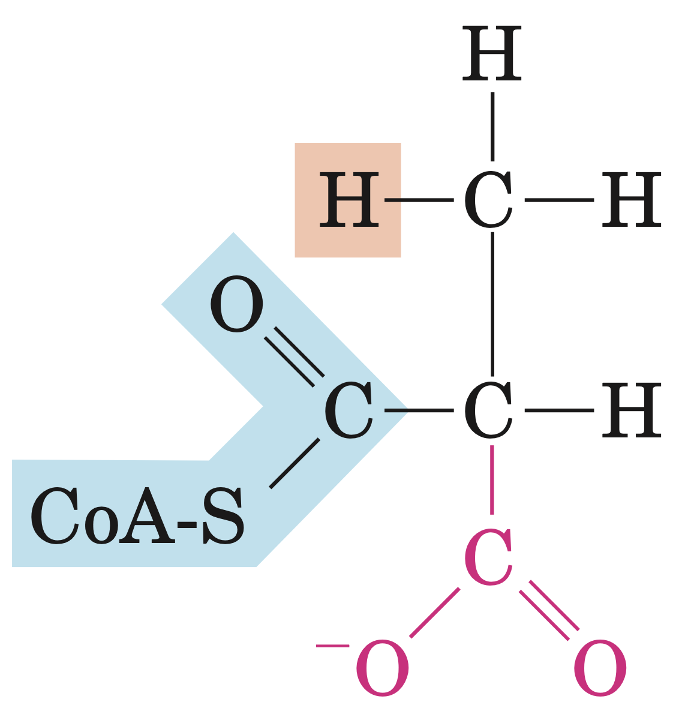
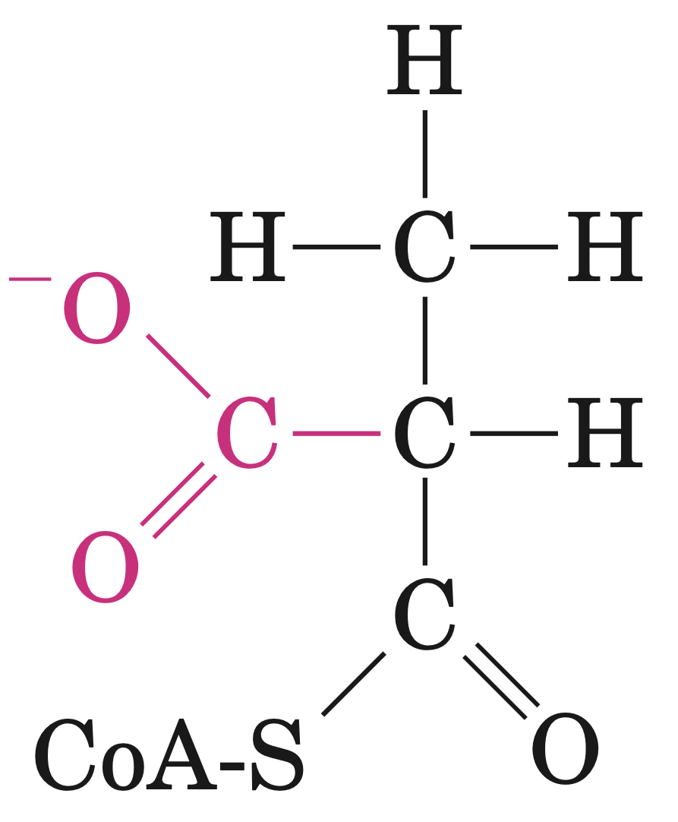
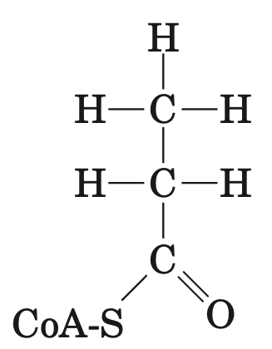
β-Oxidation
Fatty acid
Malonyl-CoA
Fatty acyl-CoA synthetase
(fatty acid thiokinase)
Cholesterol biosynthesis
Fatty acyl-carnitine
Fatty acyl-CoA
CoA-SH
Carnitine acyltransferase II
Fatty acid biosynthesis
carnitine
Acyl carnitine/carnitine transporter
carnitine
Carnitine acyltransferase I
CoA-SH
Fatty acyl-CoA
succinyl-CoA
Fatty acyl-carnitine
FAD
acyl-CoA dehydrogenase
Carnitine
FADH2
trans-Δ²-Enoyl-CoA
Methylmalonyl-CoA mutase
The citric acid cycle
Η₂Ο
enoyl-CoA hydratase
coenzyme B12
L-methylmalonyl-CoA
L-β-Hydroxy-acyl-CoA
Ketone bodies synthesis
Methylmalonyl-CoA epimerase
NAD⁺
β-hydroxyacyl-CoA dehydrogenase
NADH+H⁺
D-methylmalonyl-CoA
β-Ketoacyl-CoA
ADP+Pi
propionyl-CoA carboxylase
CoA-SH
acyl-CoA acetyltransferase (thiolase)
HCO₃⁻
Biotin
ATP
propionyl-CoA or Acetyl CoA +
Fatty acyl-CoA
Notes:
Malonyl-CoA——slide 9
Carnitine transferase I——slide 6
Carnitine transferase II——slide 6
Coenzyme B12——slide 7
cholesterol biosynthesis——slide 19
Fatty acid biosynthesis——slide 9
The citrate acid cycle——citric acid cycle
ketone bodies synthesis——slide 8
Fatty acyl-CoA synthetase(fatty acid thiokinase)——slide 5
The citric acid cycle——the citric acid cycle
Arrow——slide 1

Slide 5

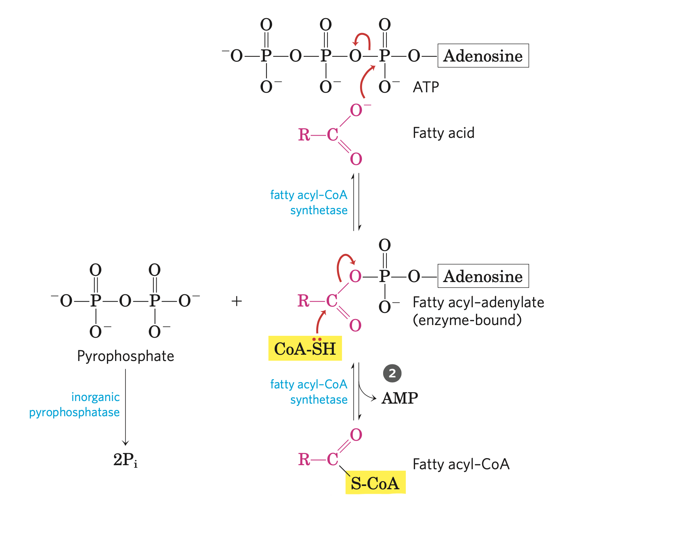
Fatty acyl-CoA synthetase
(fatty acid thiokinase)
Fatty acyl-CoA synthetase (fatty acid thiokinase):
a family of isozymes (different isozymes specific for fatty acids having short, intermediate, or long carbon chains) present in the outer mitochondrial membrane.
General reaction:
Fatty acid+CoA+ATP fatty acyl+CoA+AMP+PPi
Notes:
Arrow——slide 4

Slide 6
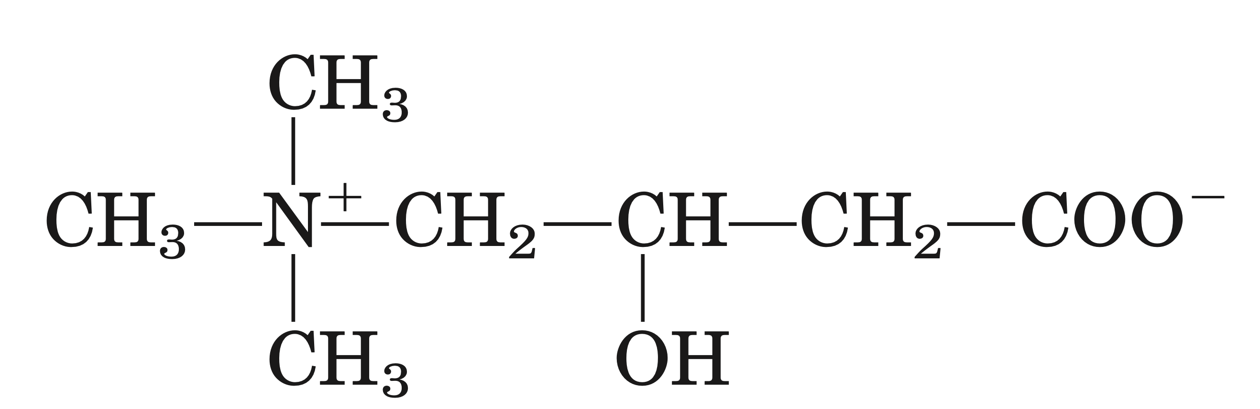
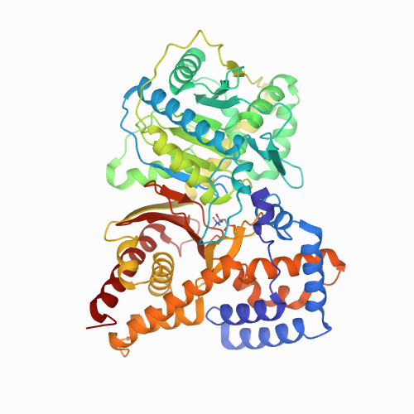
Carnitine acyltransferase I & II
Carnitine: binds to acyl groups via the hydroxyl group
Carnitine acyltransferase I:
Located on the outer membrane of mitochondria
Carnitine acyltransferase II:
Located on the inner membrane of mitochondria
The two CoA-SH pools are actually separated.
This entering step is the rate-limiting step for fatty acid oxidation.
Notes:
Arrow——slide 4

Slide 7
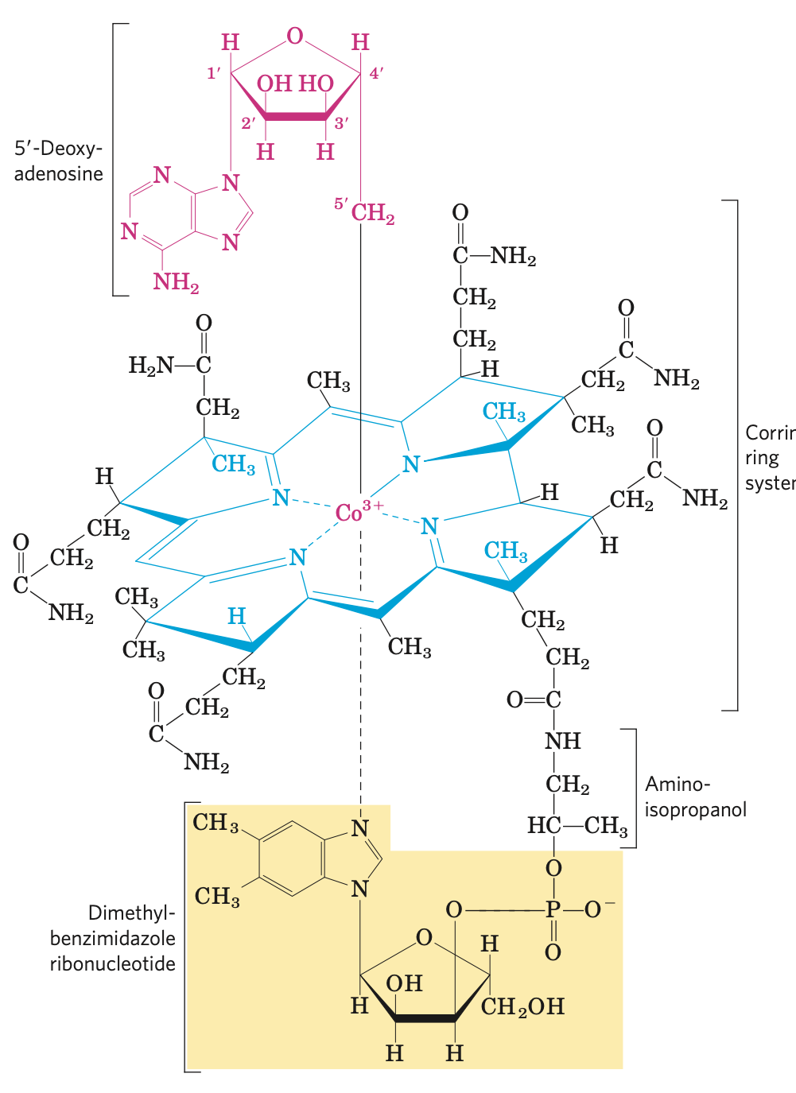
Coenzyme B12
Coenzyme B12 (cyanocobalamin):
Coenzyme B12 is the cofactor form of vitamin B12.
The complex corrin ring system of vitamin, to which cobalt (as Co³⁺) is coordinated, is chemically related to the porphyrin ring system of heme and heme proteins.
In 5’-deoxyadenosyl-cobalamin, the cofactor for methylmalonyl-CoA mutase, the cyano group is replaced C by the 5’-deoxyadenosyl group.
Catalyzes hydrogen exchange.
Notes:
Arrow——slide 4

Slide 8
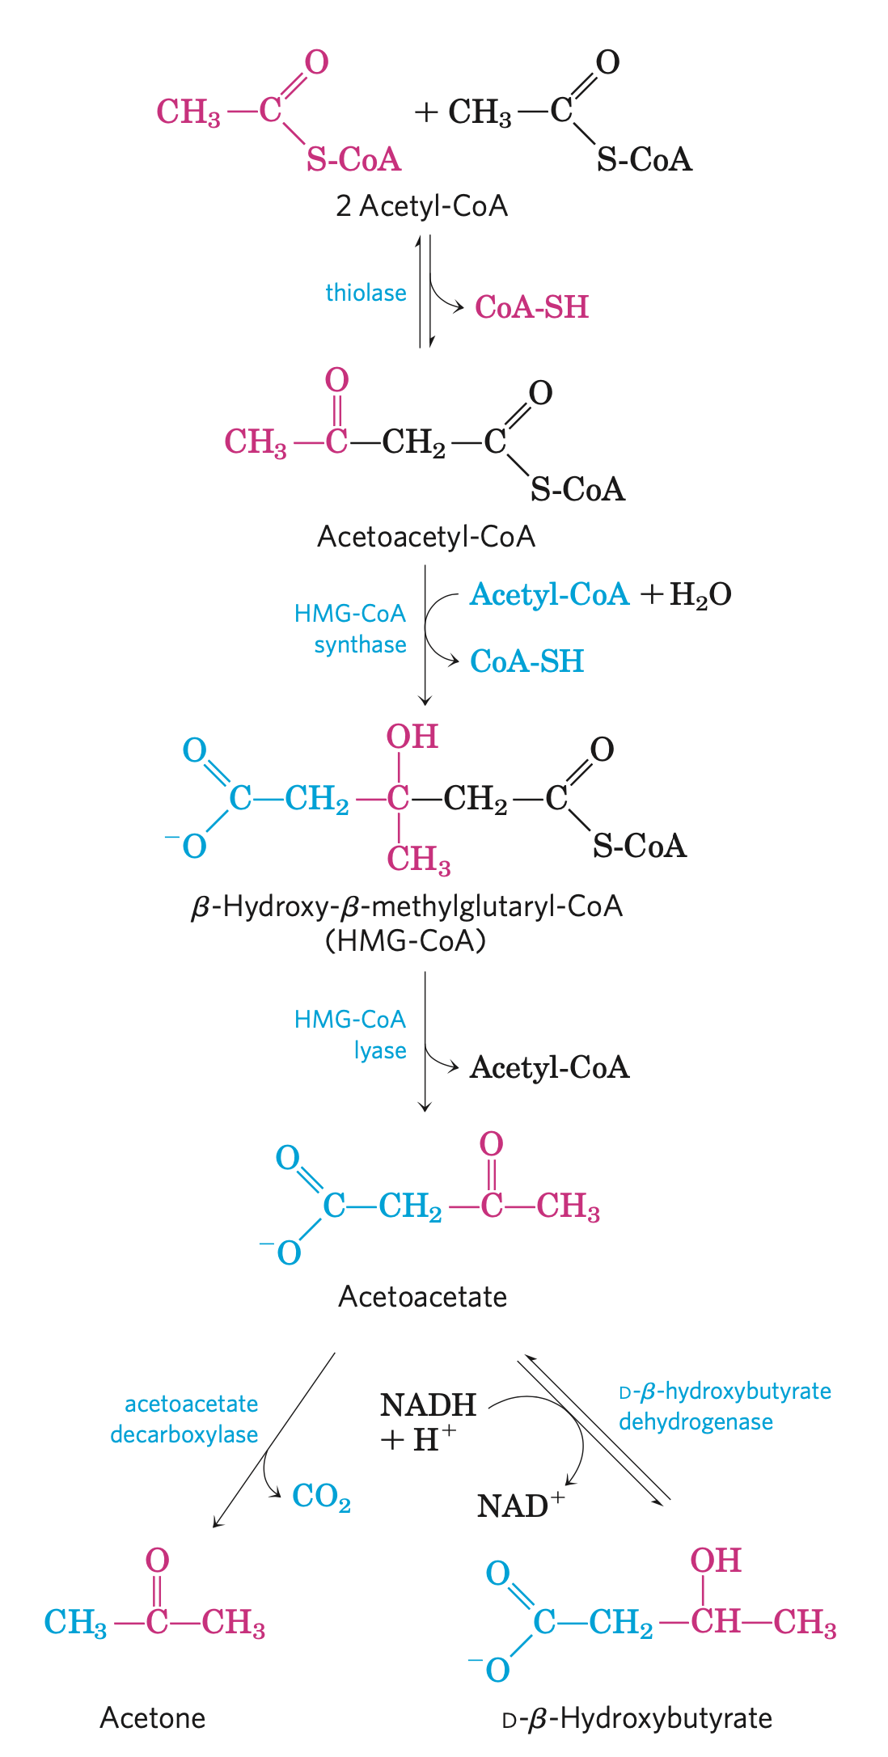
Ketone bodies synthesis and break-down
2 acetyl-CoA
thiolase
CoA-SH
Acetoacetyl-CoA
2 acetyl-CoA
Acetyl-CoA+H₂O
HMG-CoA synthase
thiolase
CoA-SH
CoA-SH
β-Hydroxy-β-methylglutaryl-CoA
(HMG-CoA)
Acetoacetyl-CoA
HMG-CoA
lyase
β-ketoacyl-CoA transferase
Succinate
Acetyl-CoA
Succinyl-CoA
acetoacetate
acetoacetate
acetoacetate decarboxylase
D-β-hydroxybutyrate dehydrogenase
D-β-hydroxybutyrate dehydrogenase
Acetone
D-β-Hydroxybutyrate
NADH+H⁺
CO₂
NADH+H⁺
NAD⁺
NAD⁺
Notes:
Arrow——slide 1

Slide 9
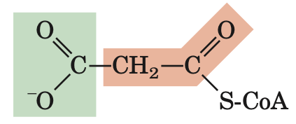
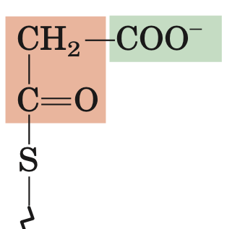
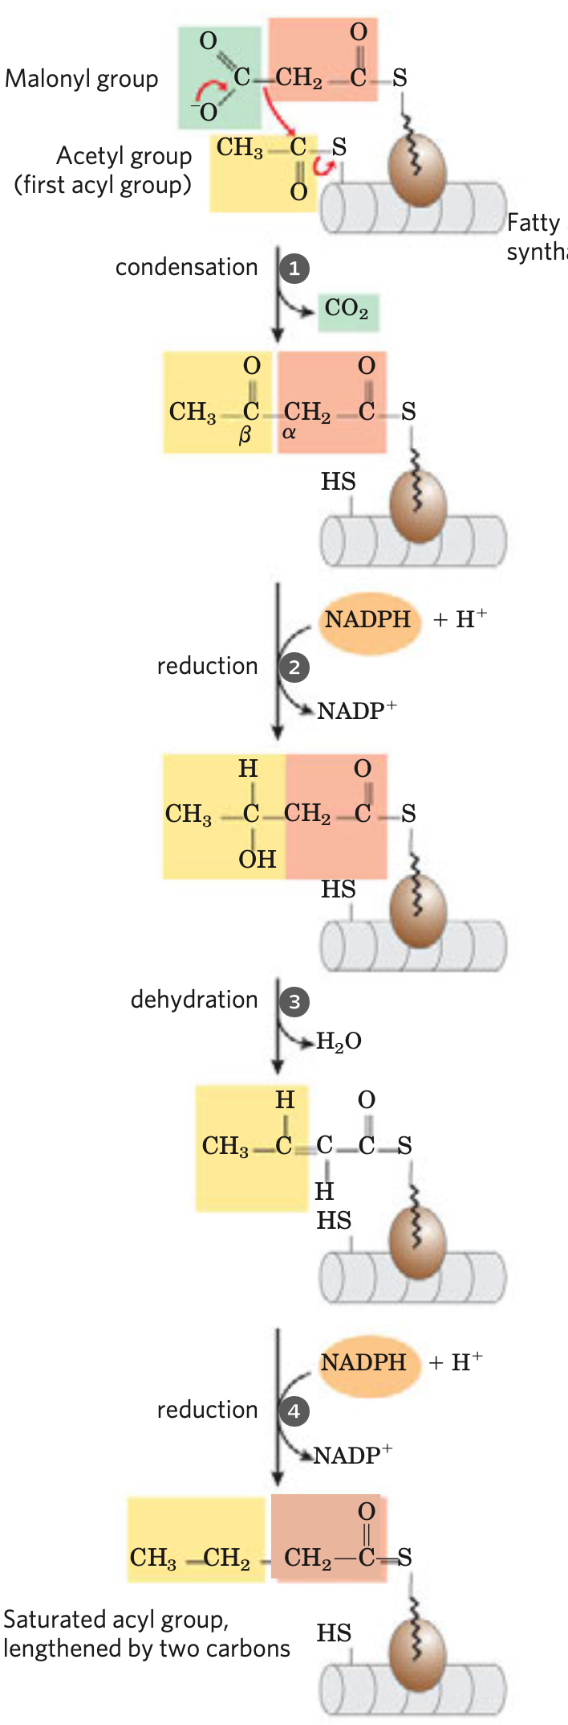
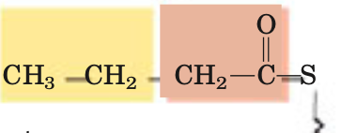
Fatty acid synthesis
Citrate
The shuttle pathway
Acetyl-CoA
Unsaturated fatty acids
Long-chain fatty acids
CoA-SH
ATP
ADP+Pi
Oxaloacetate
HCO₃⁻
Fatty acid
elongation
acetyl-CoA carboxylase
(ACC)
ATP
Palmitoyl-CoA
biotin
acetyl-CoA-ACP transferase(AT)
ADP+Pi
Fatty acid desaturation
Malonyl-CoA
Palmitate
Glucagon, epinephrine
malonyl-CoA-ACP transferase(MT)
ACP-SH
Fatty acid synthase
CoA-SH
H₂O
Malonyl-ACP
Palmitoyl-ACP
β-ketoacyl-ACP synthase(KS)
6 more additions
CO₂
β-ketobutyryl-ACP
butyryl-ACP
β-ketoacyl-ACP reductase(KR)
enoyl-ACP reductase(ER)
NADP⁺
NADPH+H⁺
NADP⁺
β-hydroxyacyl-ACP dehydratase(HD)
NADPH+H⁺
β-hydroxybutyryl-ACP
trans-Δ2-butenoyl-ACP
H₂O
Notes:
The shuttle pathway——slide 12
ACC——slide 13
Fatty acid synthase——slide 10
Arrow——slide 1

Slide 10
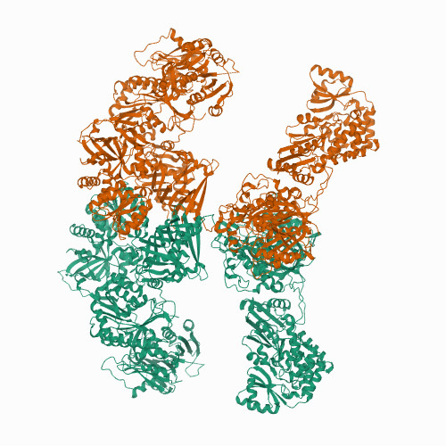
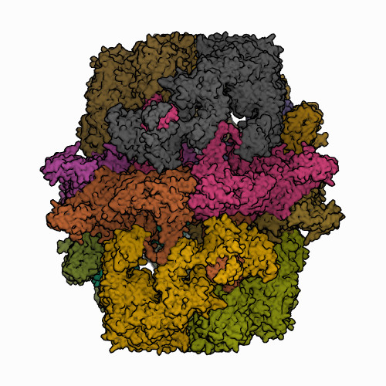
Fatty Acid Synthase
fatty acid synthase I (FAS I) :
Found in vertebrates and fungi. A single multifunctional polypeptide chain (Mr 240,000).
Mammalian FAS I: Seven active sites for different reactions lie in separate domains. Functions as a homodimer (Mr 480,000).
Yeast FAS I and fungi FAS I: two multifunctional polypeptides that form a complex. Architecture distinct from the vertebrate systems. Three of the seven required active sites are found on the α subunit and four on the β subunit.
With FAS I systems, fatty acid synthesis leads to a single product, and no intermediates are released. When the chain length reaches 16 carbons, palmitate leaves the cycle. Carbons C-16 and C-15 are derived from the methyl and carboxyl carbon atoms of an acetyl-CoA used directly to prime the system; the rest of the carbon atoms in the chain are derived from acetyl-CoA via malonyl-CoA.
The structure of 2 fatty acid synthase type I systems.

Slide 11
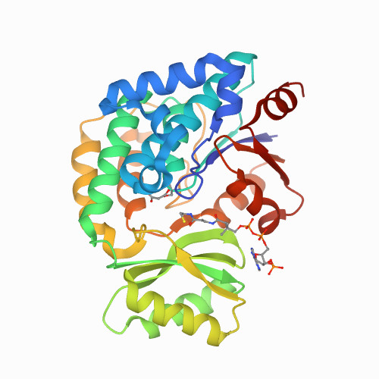
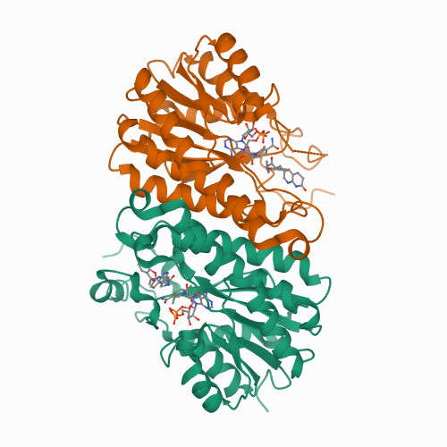
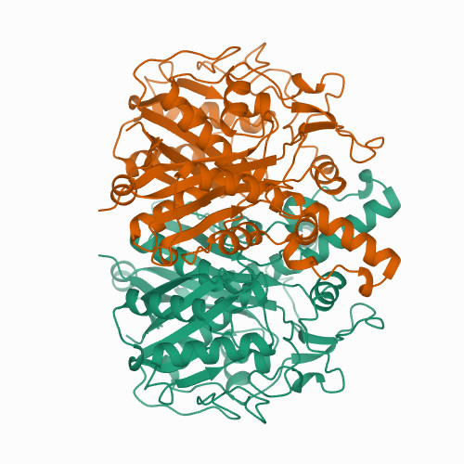
Fatty Acid Synthase
fatty acid synthase II (FAS II):
Found in plants and bacteria.
Each step in the synthesis is catalyzed by a separate and freely diffusible enzyme. Intermediates are also diffusible and may be diverted into other pathways (such as lipoic acid synthesis).
Unlike FAS I, FAS II generates a variety of products, including saturated fatty acids of several lengths, as well as unsaturated, branched, and hydroxy fatty acids.
ER
KS
MT
The structure of some separate enzymes of E.coli fatty acid synthase.
Notes:
Arrow——slide 9

Slide 12
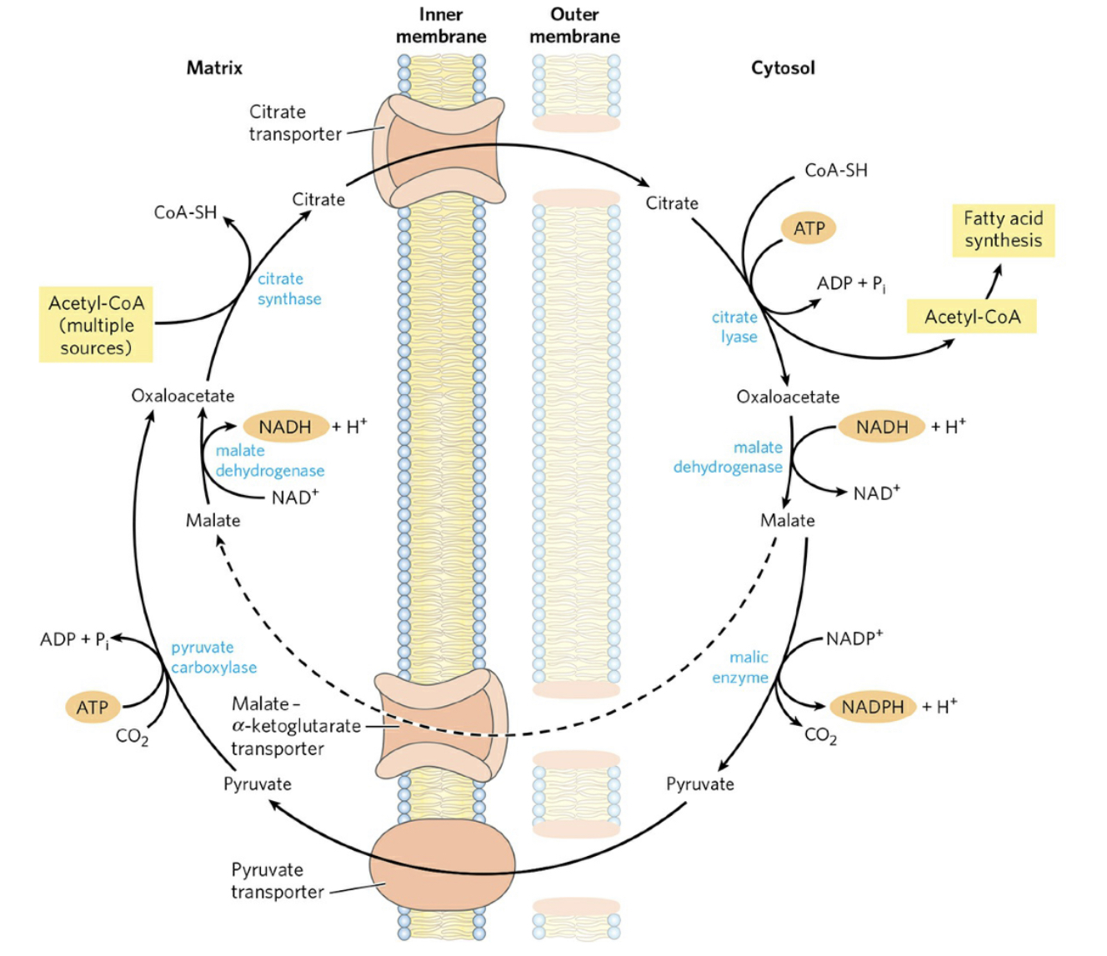
The shuttle pathway for acetyl-CoA transport
The shuttle pathway :
The outer mitochondrial membrane is freely permeable to all these compounds. Pyruvate is derived in the mitochondrial matrix, or in the
cytosol, is converted to acetyl-CoA in the matrix. Acetyl groups pass out of the mitochondrion as citrate; in the cytosol they are delivered as acetyl-CoA for fatty acid synthesis. Oxaloacetate is reduced to malate, which can return to the mitochondrial matrix and is converted to oxaloacetate. The major fate for cytosolic malate is oxidation by malic enzyme to generate cytosolic NADPH; the pyruvate produced returns to the mitochondrial matrix.
Citrate lyase
Insulin
Notes:
Arrow——slide 9

Slide 13
Acetyl-CoA carboxylase (ACC)
Acetyl-CoA carboxylase (ACC): Catalyze the committing and rate-limiting step of fatty acid synthesis.
Regulated by allosteric effectors and reversible phosphorylation.
Allosteric regulation:
Allosterically inhibited by palmitoyl-CoA and activated by citrate.
Glucagon and epinephrine triggers the phosphorylation and disassociation of the polymeric enzyme subunits
Citrate partially activates the phosphorylated acetyl-CoA carboxylase.
In plants, acetyl-CoA carboxylase is activated by an increase of Mg⁺ concentration and a decrease of H⁺ concentration that accompany illumination.
Phosphorylation/dephosphorylation:
Insulin phosphatase ACC dephosphorylated ACC activated
Glucagon PKA ACC phosphorylated ACC inactivated
Notes:
Arrow——slide 9

Slide 14
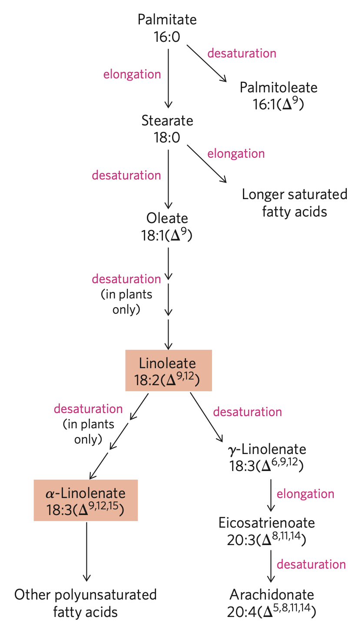
Fatty acid elongation systems
Fatty acid elongation takes place in smooth ER and mitochondria.
Coenzyme A rather than ACP is the acyl carrier in the reaction.
Donation of two carbons by malonyl-CoA.
leukotrienes
Eicosanoids
Notes:
Arrow——slide 9

Slide 15
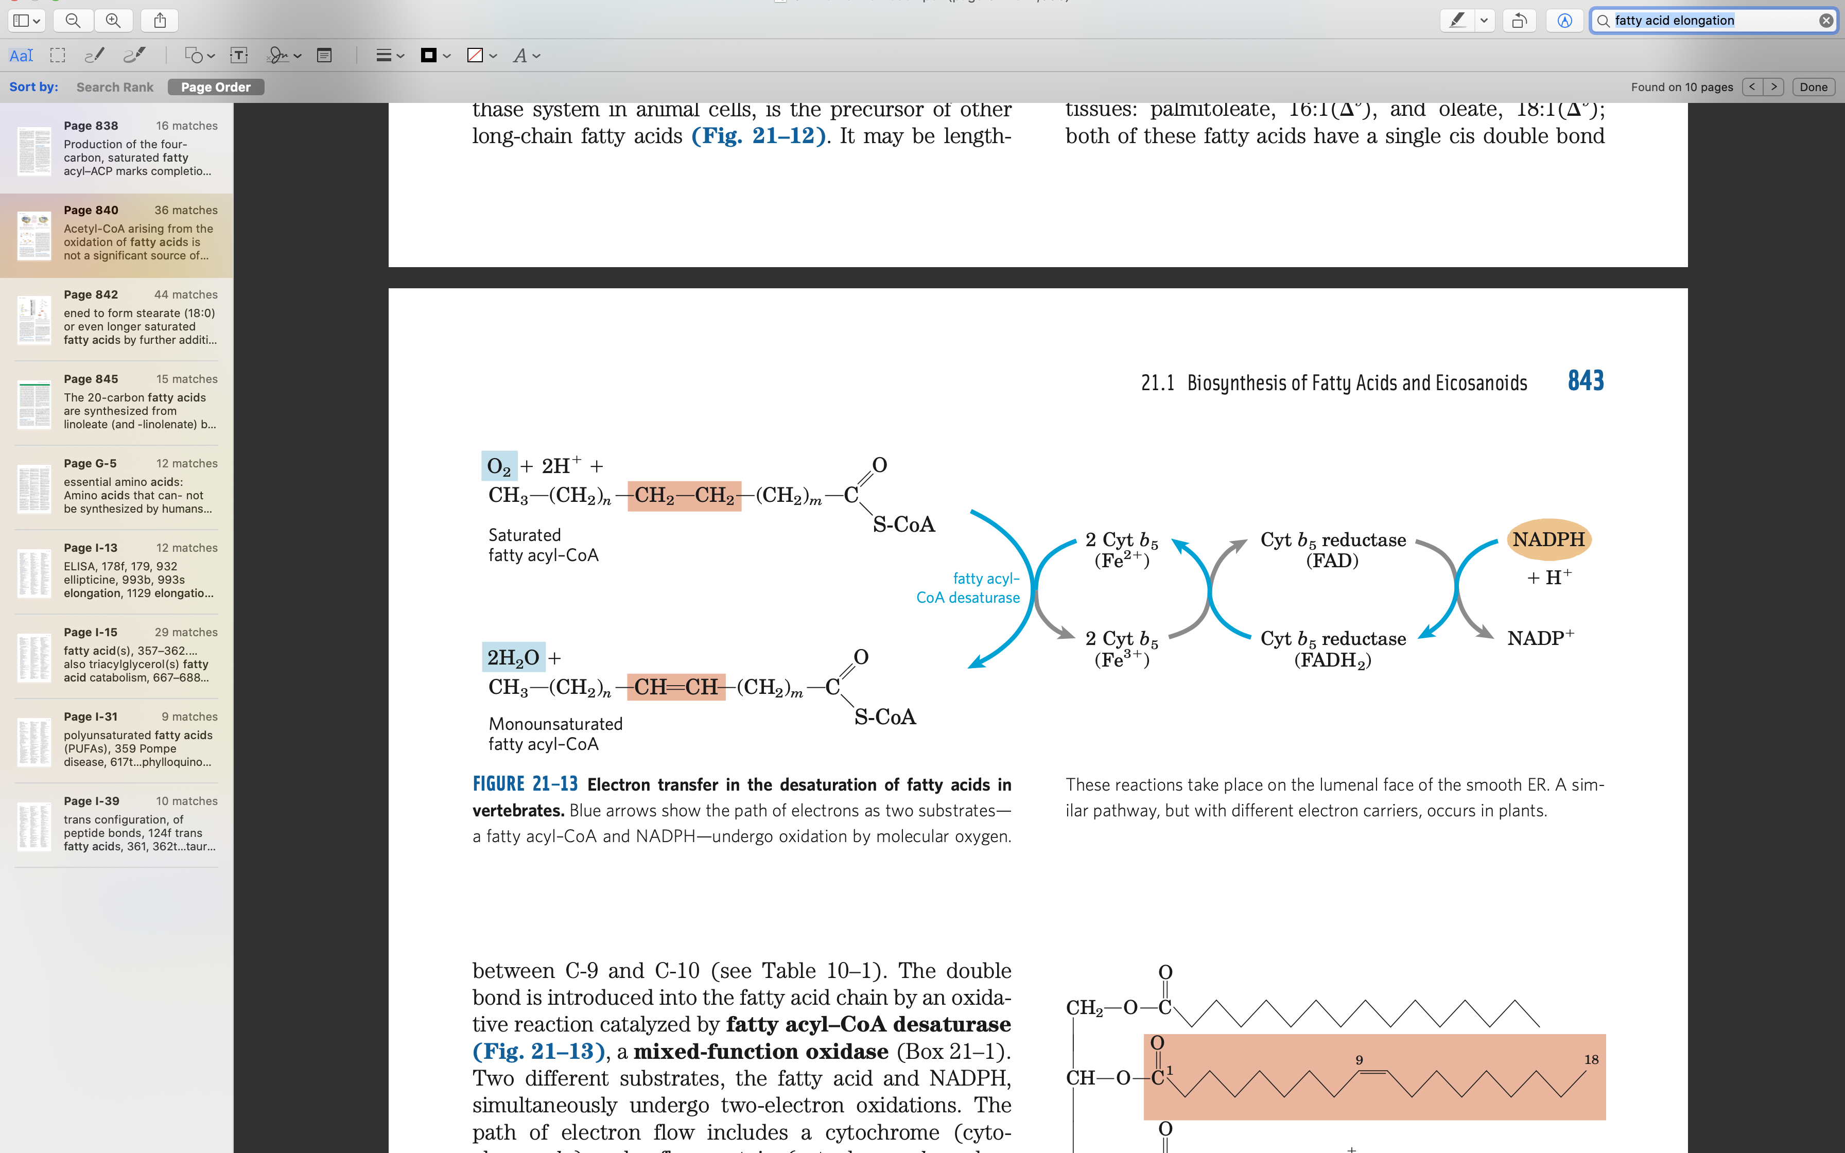
Fatty acid desaturation
Takes place in the smooth ER and plastid, chloroplast & cytosol in plants.
Polyunsaturated fatty acids can only derive in plants.
fatty acyl–CoA desaturase
Palmitate 16:0
Palmitoleate 16:1 (Δ⁹)
elongation
fatty acyl–CoA desaturase
desaturases
Stearate 18:0
Oleate 18:1(Δ⁹)
desaturases
Linoleate 18:2(Δ ^{9,12})
α-Linolenate 18:3(Δ^{9,12,15})
stearoyl-ACP desaturase (SCD) in chloroplast stroma in plants
In ER and the chloroplast in plants
In ER and the chloroplast in plants
Notes:
Arrow——slide 9

Slide 16
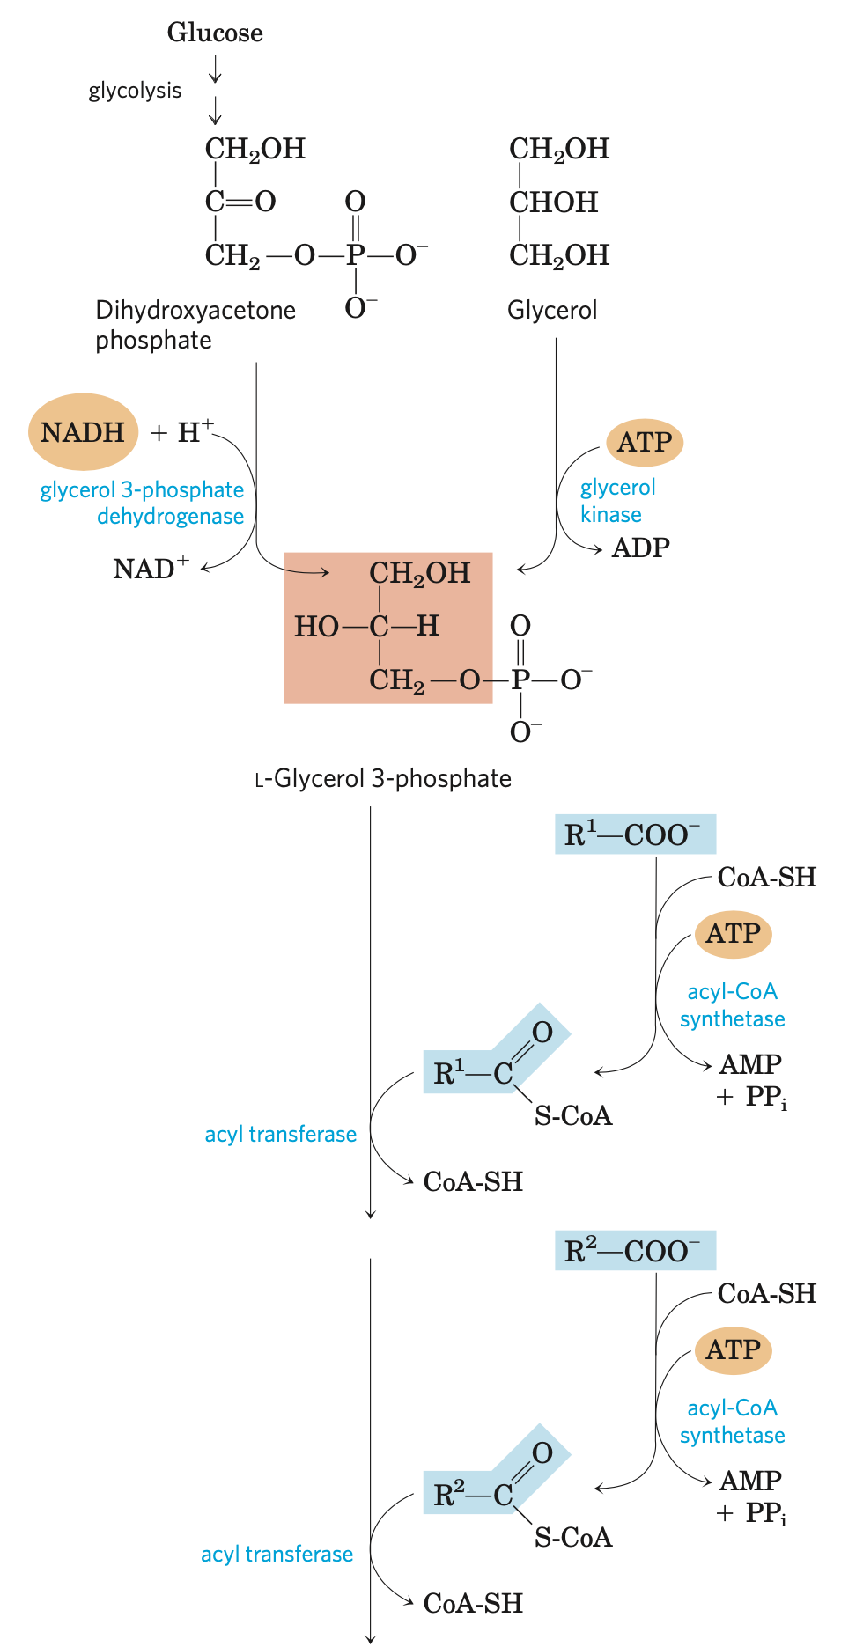
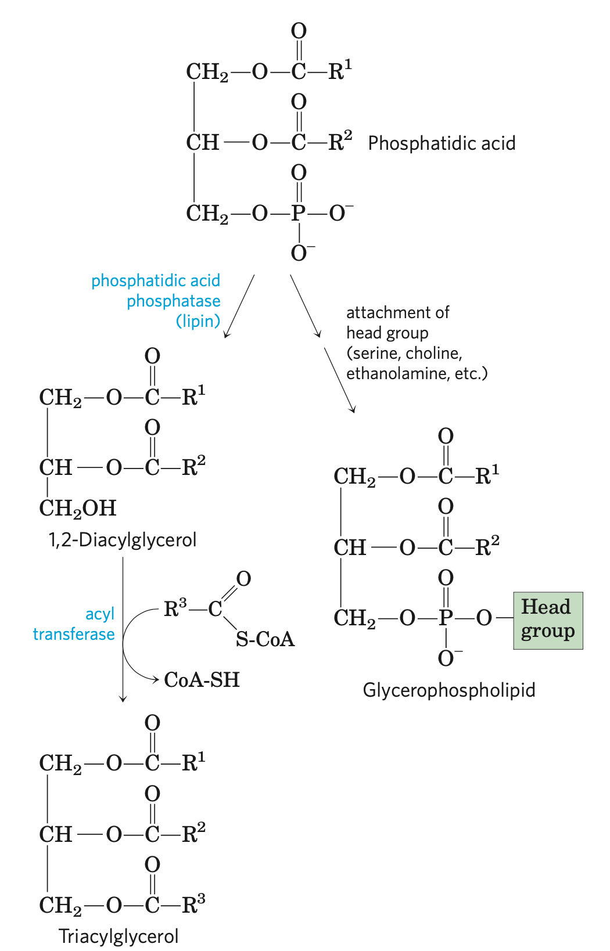
Synthesis of triacylglycerols and glycerophospholipids
In general, the assembly of phos- pholipids from simple precursors requires:
synthesis of the backbone molecule (glycerol or sphingosine);
attachment of fatty acid(s) to the backbone through an ester or amide linkage;
addition of a hydrophilic head group to the backbone through a phosphodiester linkage; and, in some cases;
alteration or exchange of the head group to yield the final phospholipid product.
Notes:
Arrow——slide 1

Slide 17
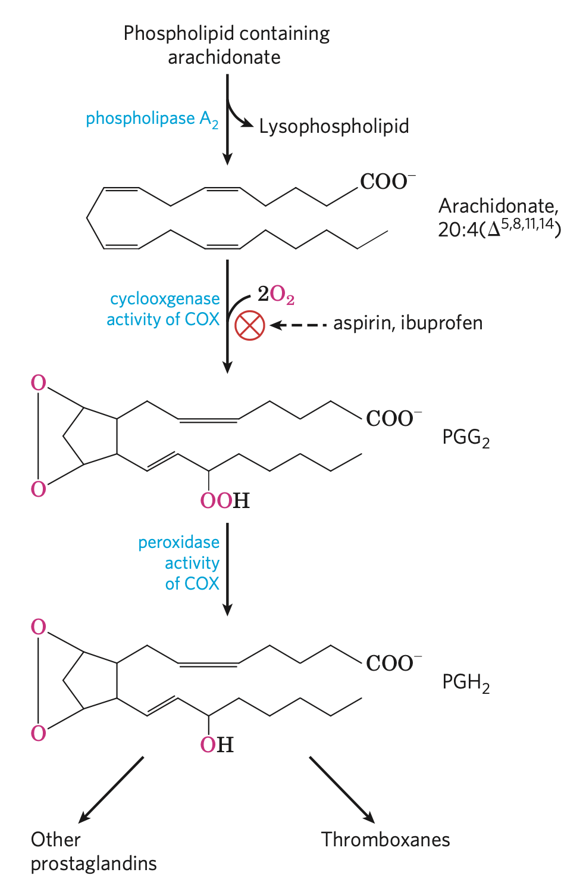
Synthesis of eicosanoids
Mammals have two isozymes of prostaglandin H2 synthase, COX-1 and COX-2.
COX-1: synthesis of the prostaglandins that regulate the secretion of gastric mucin
COX-2: synthesis of the prostaglandins that mediate inflammation, pain, and fever.
Other thromeboxanes
thromboxane A2
Thromboxane
synthase
prostaglandins
the “cyclic” pathway
Notes:
Arrow——slide 1

Slide 18
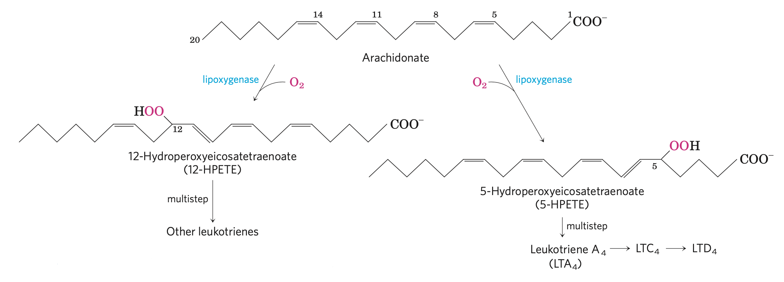
Synthesis of leukotrienes
glycerophospholipids
These lipoxygenases, found in leukocytes and in heart, brain, lung, and spleen, are mixed-function oxidases of the cytochrome P-450 family.
the “linear” pathway
Notes:
Arrow——slide 1

Slide 19
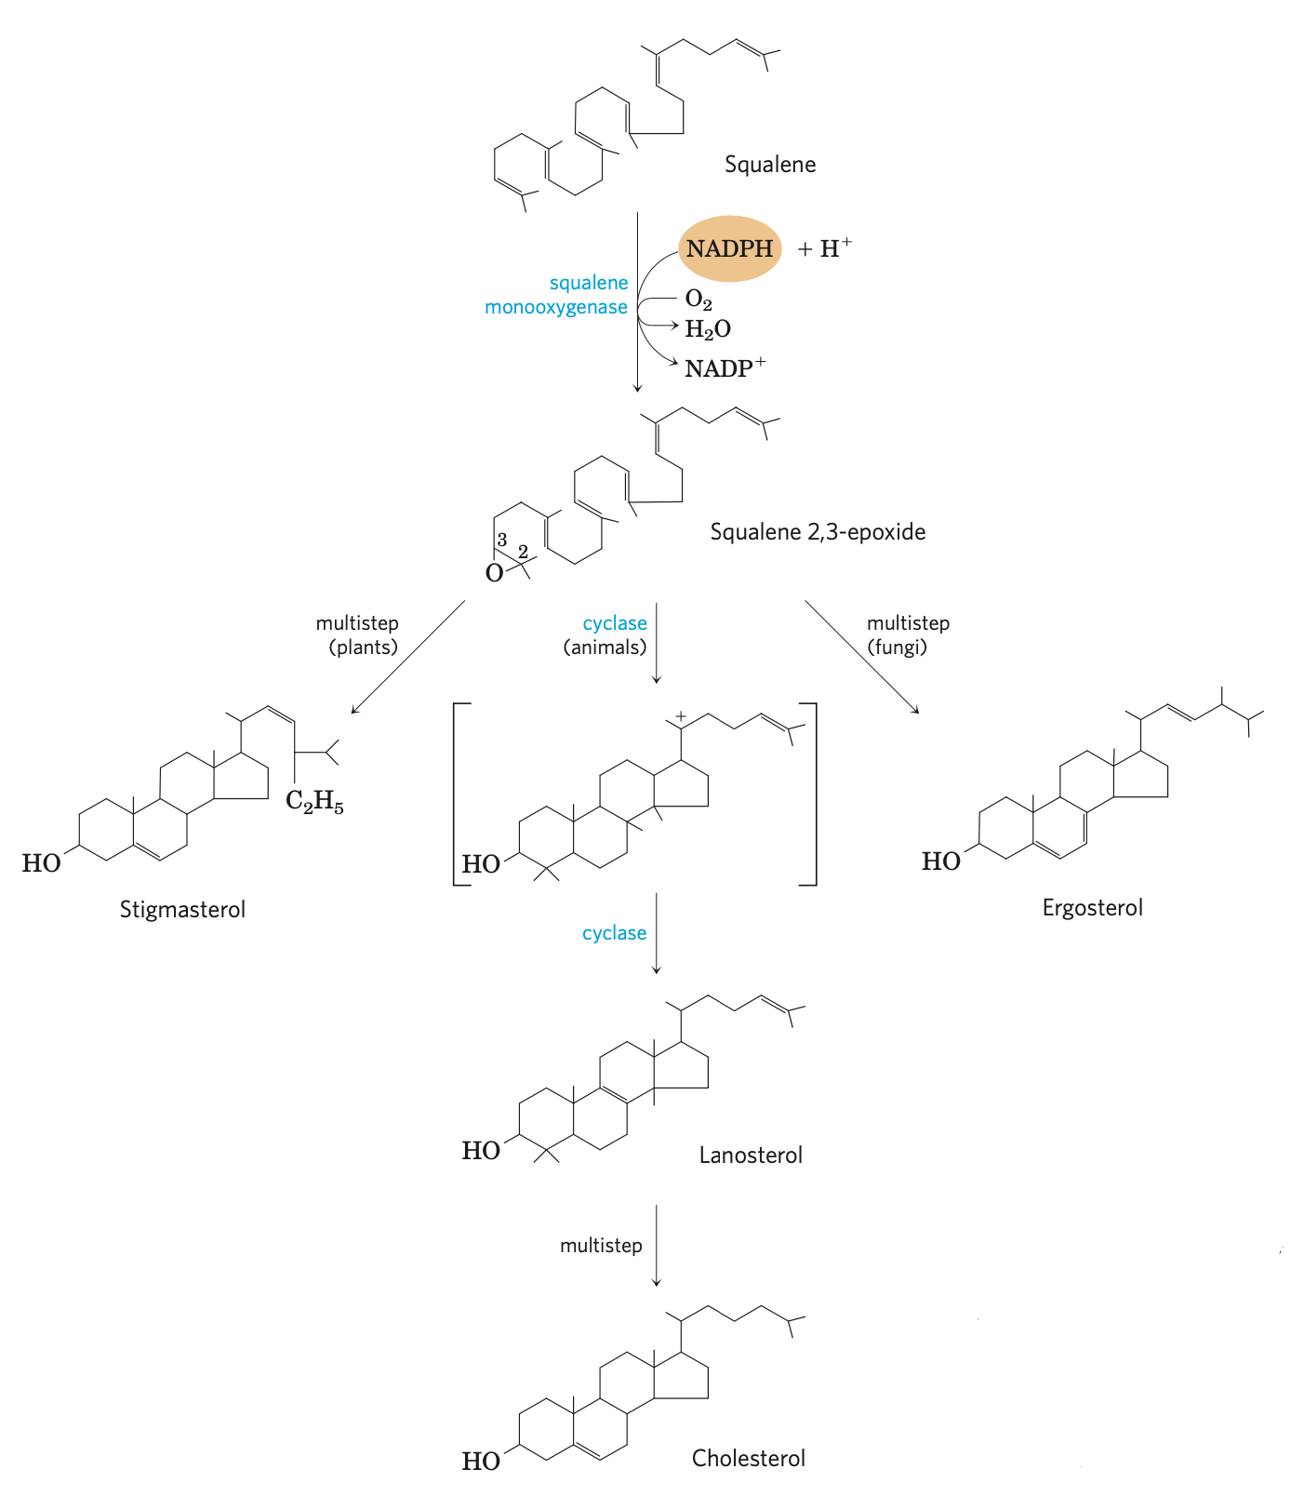
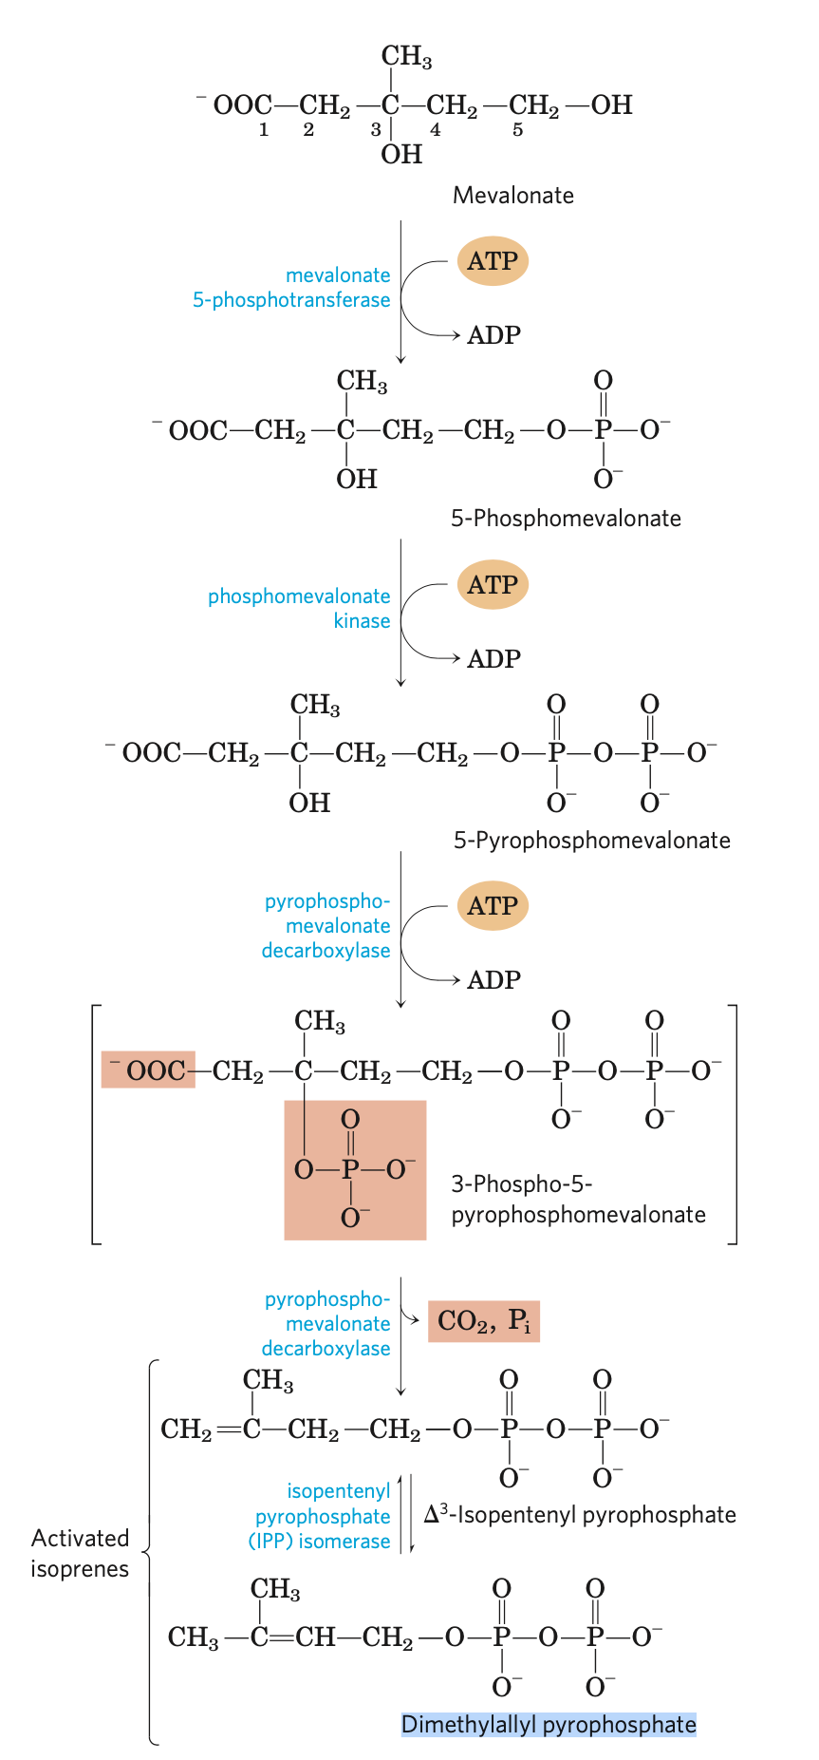
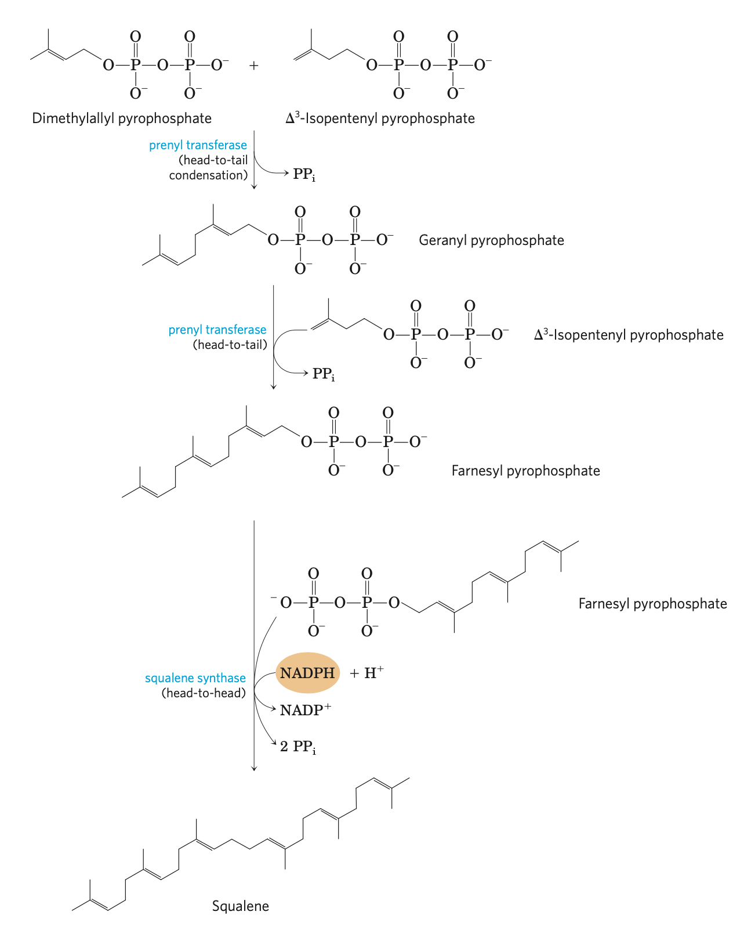
Synthesis of cholesterols
12 acetyl-CoA
Steroid hormones
acetyl-CoA acetyl transferase
CoA-SH
6 Acetoacetyl-CoA
pregnenolone
6 Acetyl-CoA+H₂O
Cholesterol esters
HMG-CoA synthase
Bile salts
Stage 1
6 CoA-SH
6 β-Hydroxy-β-methylglutaryl-CoA
(HMG-CoA)
Cholesterols
HMG-CoA reductase
12 NADPH+12H⁺
Stage 4
12 NADP⁺
6 CoA-SH
Squalene 2,3-epoxide
(the Four-Ring Steroid Nucleus)
6 Mevalonate
18 ATP
Stage 2
18 ADP
Stage 4
NADPH+H⁺
6 PPi
6 CO₂+6 Pi
NADP⁺
6 Δ³-Isopentenyl pyrophosphate
Squalene
Stage 3
Pigments
Fragrant principles vitamin(A,E,K) quinones
6 Dimethylallyl pyrophosphate
Isoprenoids
Notes:
HMG-CoA reductase——slide 23

Slide 20
Stage 2
Notes:
Arrow——slide 19

Slide 21
Stage 3
Notes:
Arrow——slide 19

Slide 22
Stage 4
Notes:
Arrow——slide 19

Slide 23
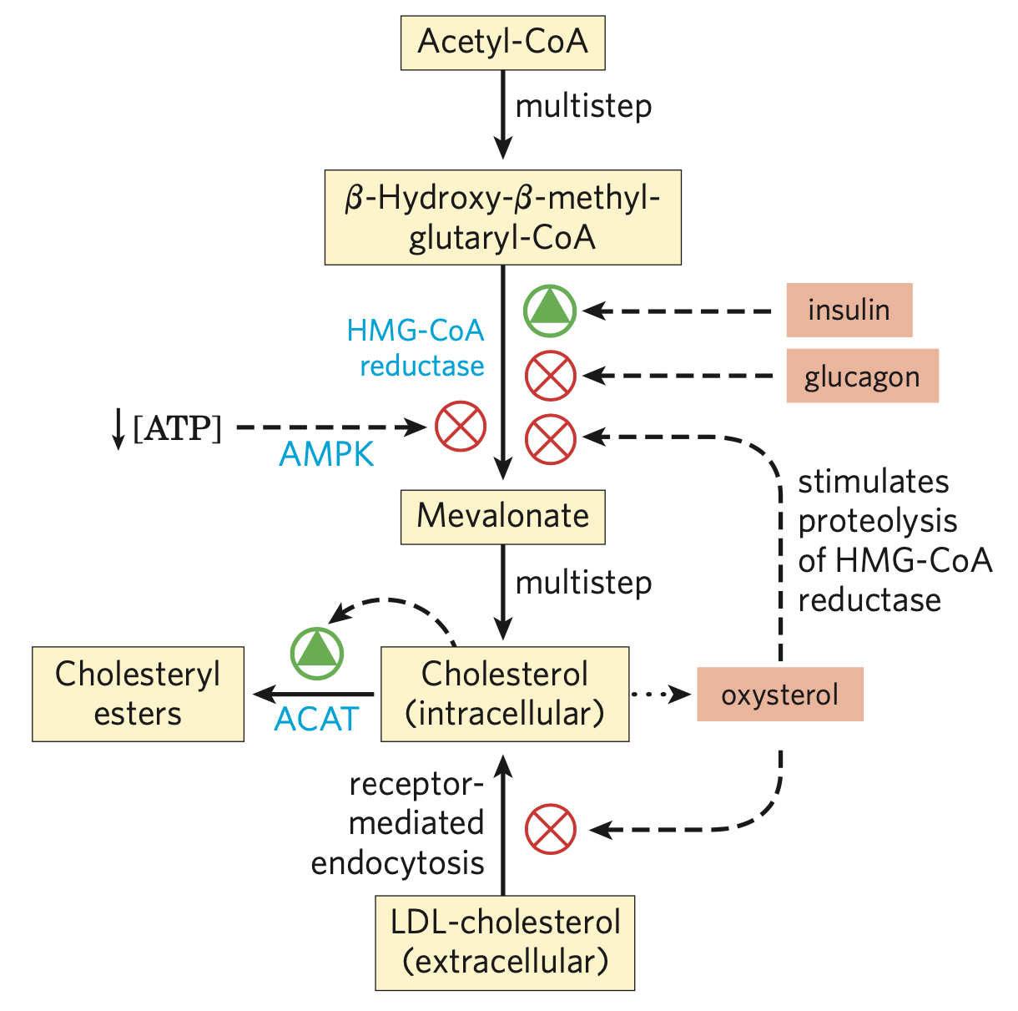
HMG-CoA reductase
HMG-CoA reductase: an integral membrane protein of the smooth ER, the major point of regulation on the pathway to cholesterol. It catalyzes the rate-limiting step of the de novo cholesterol synthesis.
Expression regulation:
by sterol regulatory element-binding proteins (SREBPS).
Hormone regulation: insulin activation
glucagon inactivation
Notes:
Arrow——slide 19

